Slide 1
Pediatric Chest X-ray Image Classification for Pneumonia Detection
Presented by: Karankumar Patel
Date: April 11th, 2024

Slide 2
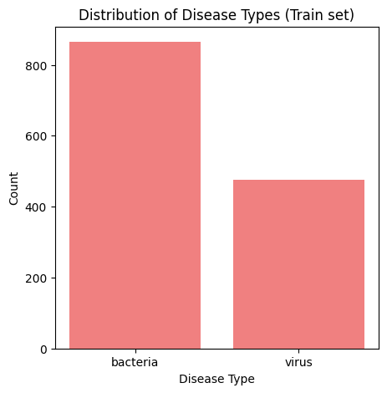
Introduction
The objective is to develop an AI system that accurately classifies chest x-ray images into Pneumonia and Normal categories.
Chest X-ray images were taken from a group of kids aged one to five at Guangzhou Women and Children’s Medical Center in Guangzhou, China. These X-rays were taken during their regular hospital visits.

Slide 3
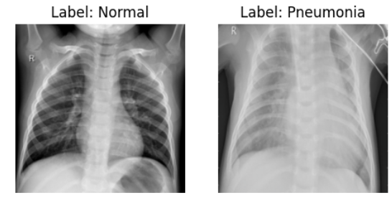
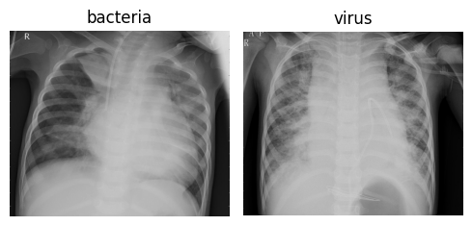
Data Collection & Preprocessing
Data Source: Kaggle
Total images across sets: 3,322 chest X-ray images, comprising 2,682 images in the training set, 624 in the validation set, and 16 in the test set.
Preprocessing Steps:
All images were resized to a uniform size of 224x224 pixels
to match the input size expected by ResNet model.
Then images were converted into tensors, a format suitable
for deep learning algorithms.
Pixel values were standardized across the three-color
channels using mean=[0.485, 0.456, 0.406] and
std=[0.229, 0.224, 0.225].

Slide 4
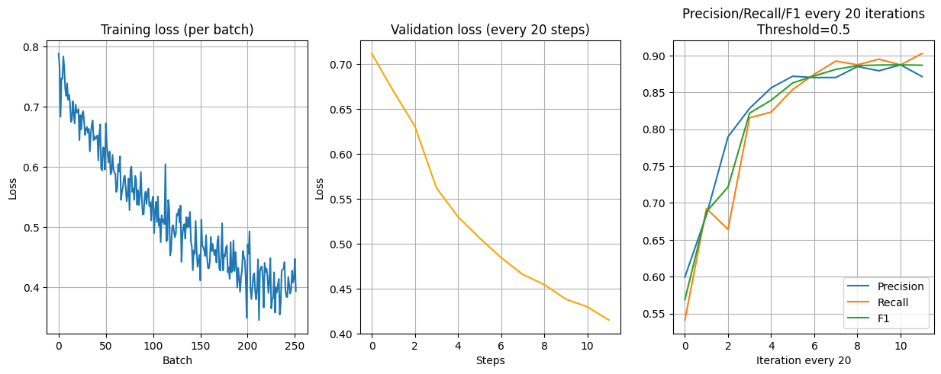
Model Training & Evaluation
Model: ResNet18
Loss Function: BCEWithLogitsLoss
Optimizer: SGD
Learning rate: 0.001
Threshold: 0.5
During training, the model achieved an accuracy of 88.52%, while during validation, it reached 85.58%. The training loss was 0.525, and the validation loss was 0.414. Additionally, the model achieved a precision of 87.13%, a recall of 90.26%, and an F1 score of 0.8866. (Iteration 240)

Slide 5
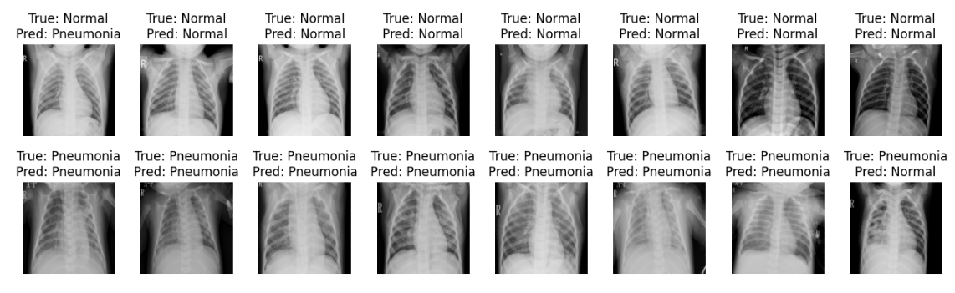
Evaluation on Test Data

Slide 6
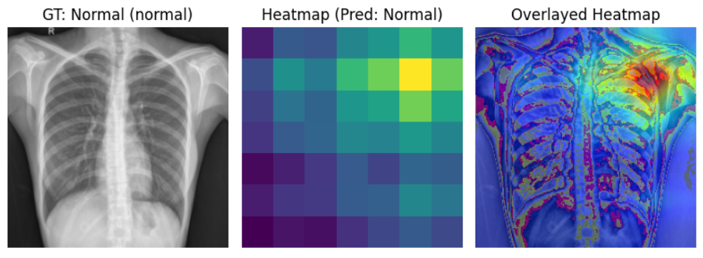
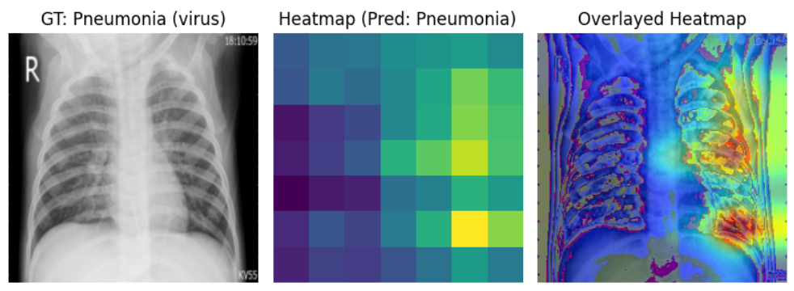
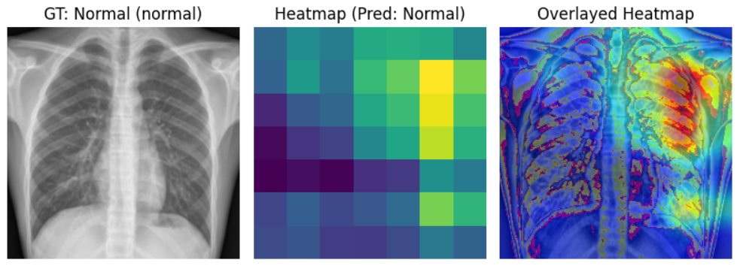
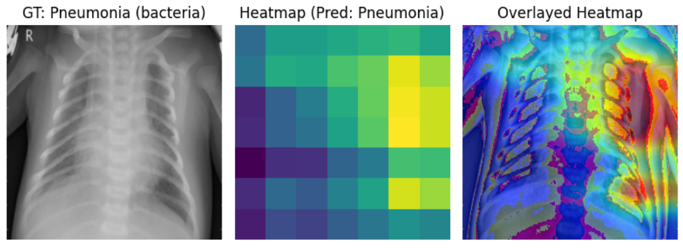
Results & Interpretation
Normal Images
Pneumonia Images

Slide 7
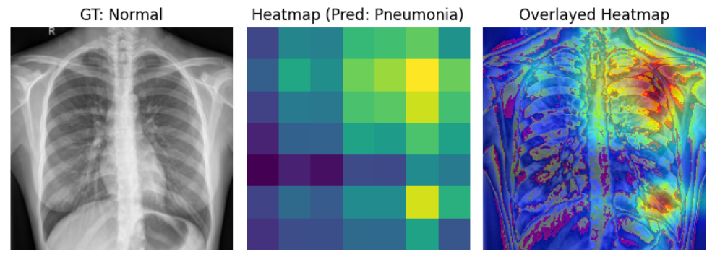
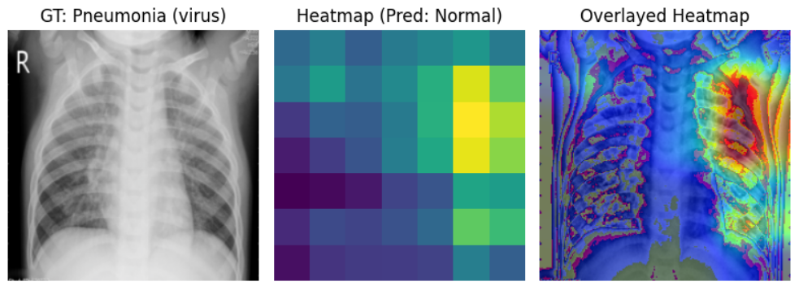
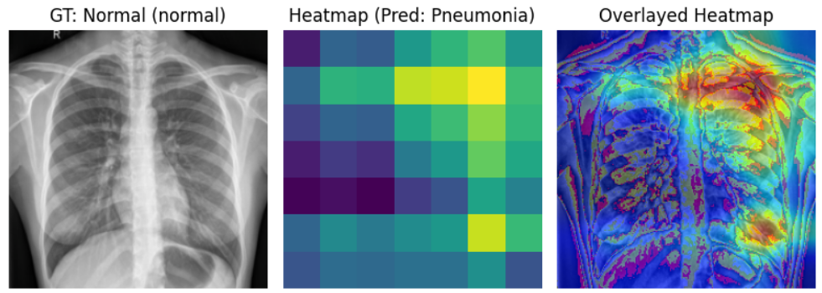
Cases when model failed

Slide 8
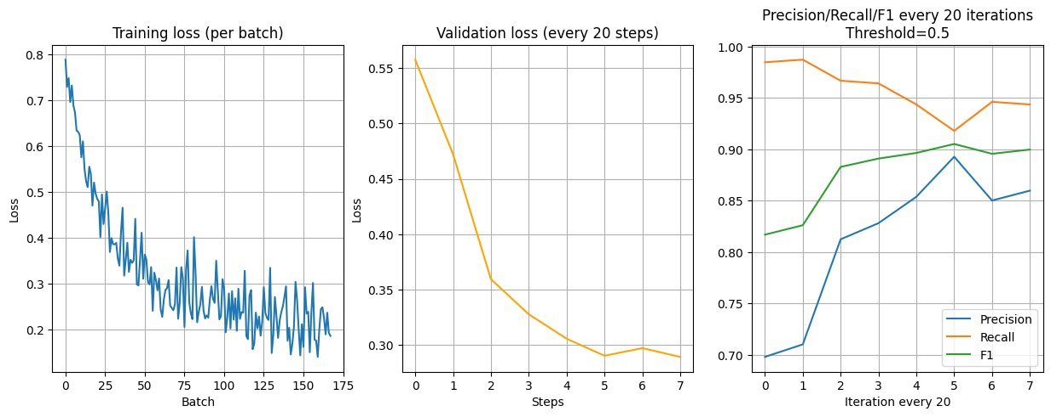
Continued
Model: ResNet18
Loss Function: BCEWithLogitsLoss
Optimizer: Adam
Learning rate: 0.001
Threshold: 0.5
During training, the model achieved an accuracy of 91.09%, while during validation, it reached 87.98%. The training loss was 0.356, and the validation loss was 0.290. Additionally, the model achieved a precision of 89.28%, a recall of 91.79%, and an F1 score of 0.9052. (Iteration 120)

Slide 9
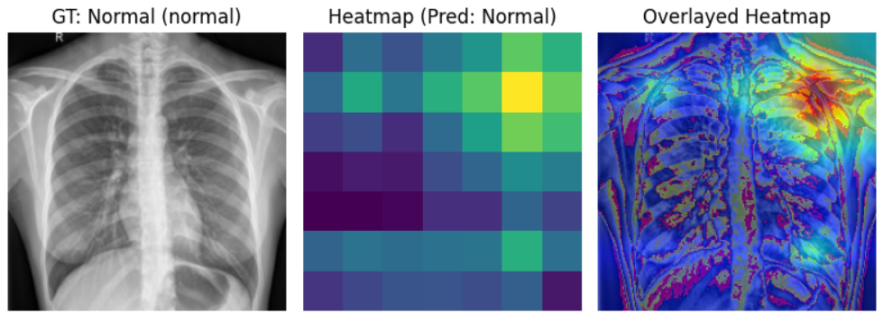
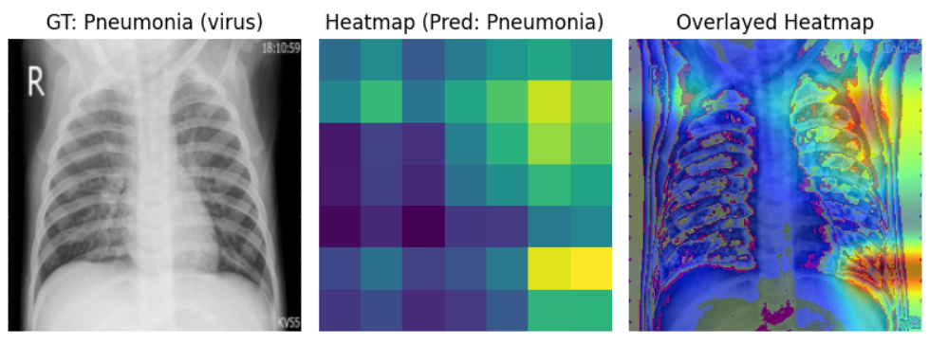
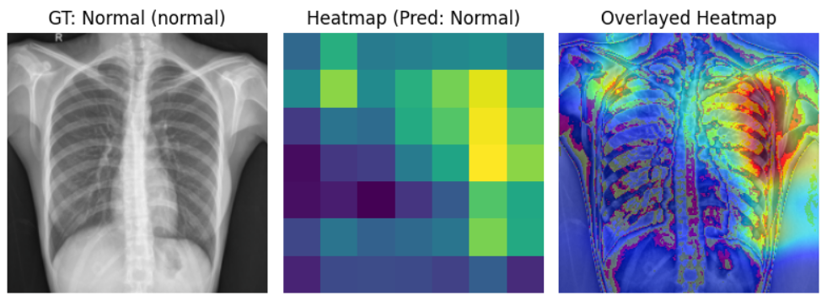
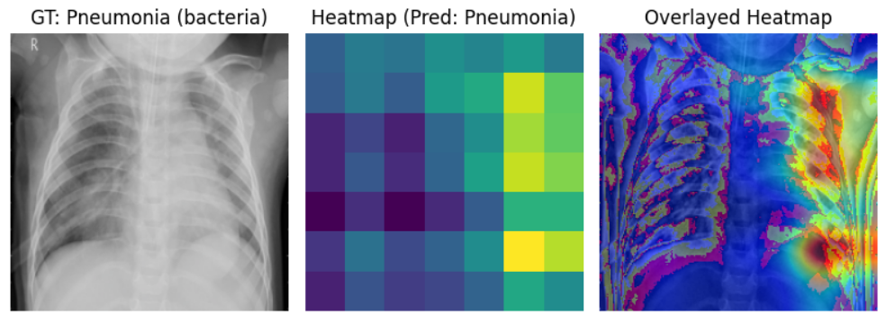
Results & Interpretation
Normal Images
Pneumonia Images

Slide 10
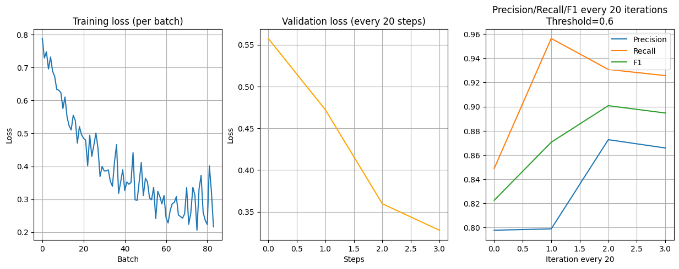
Model: ResNet18
Loss Function: BCEWithLogitsLoss
Optimizer: Adam
Learning rate: 0.001
Threshold: 0.6
During training, the model achieved an accuracy of 88.93%, while during validation, it reached 83.97%. The training loss was 0.452, and the validation loss was 0.359. Additionally, the model achieved a precision of 87.26%, a recall of 93.08%, and an F1 score of 0.9007. (Iteration 60)

Slide 11
Future Work
The model doesn't show exactly where pneumonia is. Adding semantic segmentation could fix this, making our diagnosis even better.
We can explore using semantic segmentation to find exactly where pneumonia is in the image. This helps doctors pinpoint the problem area more accurately.

Slide 12
Thank you

